Slide 1
Part 2: AC Circuits
Sinusoids and Phasors
Sinusoidal Steady-State Analysis
AC Power Analysis
Three-Phase Circuits
Magnetically Coupled Circuits

Slide 2
Chapter 9 Sinusoids and Phasors
Introduction
Sinusoids
Phasors
Phasor relationships for circuit elements

Slide 3
Chapter 9 Sinusoids and Phasors
Impedance and admittance
Kirchhoff’s laws in the frequency domain
Impedance combinations

Slide 4
Chapter objectives
Understand how to represent sinusoids by phasors
Grasp phasor relationships of the three basic elements (R ,L and C)
Introduce the concepts of impedance and admittance
Learn about Kirchhoff’s laws in the frequency domain
Discuss impedance combinations

Slide 5
Key points
Sinusoid Phasor transformation
Phasor relationships for circuit elements
The basic laws in the frequency domain
Phasor diagram

Slide 6
Difficult points
Understanding the concepts of sinusoids and phasors
Phasor relationships for circuit elements
Sinusoidal circuit analysis using phasor diagram

Slide 7
9.1 Introduction
A sinusoid is a signal that has the form of the sine or cosine function.
Alternating current :a sinusoidal current is usually referred to as ac.
ac circuits: circuits driven by sinusoidal current or voltage sources are called alternating current circuits.

Slide 8
9.2 Sinusoids
Characteristics of Sinusoids
Sinusoids with different phases
Average and effective value

Slide 9
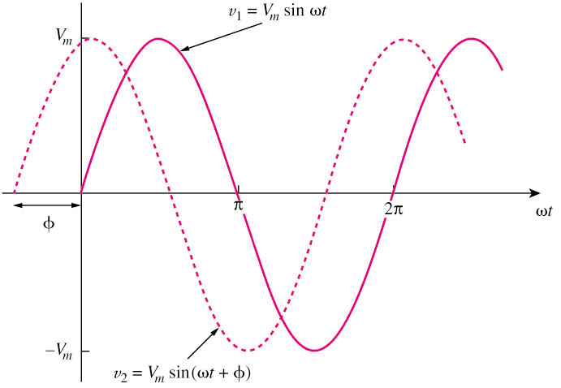

Characteristics of Sinusoids
A sinusoid is a signal that
has the form of the sine or
cosine function.
V_{m} = the amplitude of the sinusoid
ω = the angular frequency in radians/s (rad/s)
Ф = the initial phase
T = the period of the sinusoid in seconds (s)
f = the cyclic frequency of the sinusoid in hertz (Hz).
$v\left(t\right)=V_{m}$cos(wt+ Ф)

Slide 10
Characteristics of Sinusoids
Phase is the value of the argument at t =0, which is related to the time starting point.
Generally
- π ≤ φ_{i} ≤ π
i
i(t)=I_{m}cos(ω t+φ_{i})
i
i
Im
0
0
0
0
t
0
ω t
φ_{i}
φ_{i} =
-90⁰
φ_{i}
φ_{i} =0
φ_{i} = π
φ_{i}

Slide 11
Sinusoids with different phases
Leading, lagging ，in phase，out of phase
The reference sinusoid：u=U_{m}cos(ωt), then i=I_{m}cos(ωt-φ)
The reference sinusoid：i=I_{m}cos(ωt), then u=U_{m}cos(ωt+φ)

Slide 12
Characteristics of Sinusoids
Only sinusoids with the same frequency can be permitted to discuss their amplitudes and phase differences.
If the phase difference is zero, they are in phase; if the phase difference is not zero, then they are out of phase.

Slide 13
Average and effective value
a. Average Value
The average current is the average of the instantaneous currents over one period.
The average power is the average of the instantaneous powers over one period.

Slide 14
b. Effective Value
The effective value of a periodic current is the dc current that delivers the same average power to a resistor as the periodic current.
rms：root-mean-square, the square root of the mean (or average) of the square of ….

Slide 16
c. Effective Value of Sinusoid

Slide 17
9.3 Phasors
Complex Number Review
Phasor idea
Phasor diagram
Phasor transformation

Slide 18
Complex Number Review
Mathematic Forms of the Complex Number
Basic Operations of Complex Numbers

Slide 19
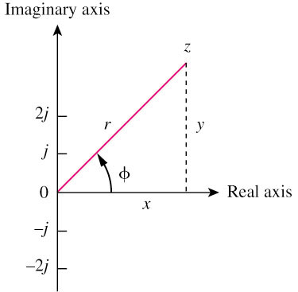
Mathematic Forms
Complex number z = x + jy
It can be represented in one of the following three forms:
: Real part
: Imaginary part
: Imaginary unit
where
Algebraic
Exponential
Polar
Euler’s identity

Slide 20
Basic Operations of Complex Numbers
Addition
Subtraction
Multiplication
Division
Reciprocal
Square root
Complex conjugate
Euler’s identity

Slide 21
Rotating factor in complex operation
Ae^{jϕ}
A is rotated counterclockwise by ϕ degree
＋j
+1
0
e^{jϕ} ,+j , –j , -1 can be regarded as rotating factors

Slide 22
Phasor idea
Euler’s formula:

Slide 23
Phasor idea
Sinusoidal Voltage
Phasor

Slide 24
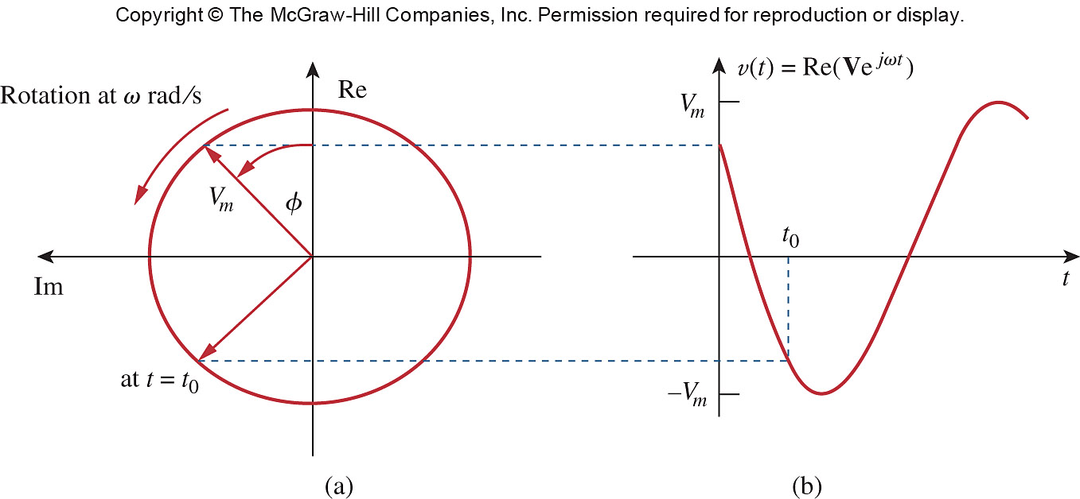
Rotating point in the complex plane
Notes:
ale29559_09007.jpg

Slide 25
Phasor Diagram
w
＋j
The axes can always be ignored
ϕ _{u}
ϕ _{i}
0
＋1
Only phasors with the same w can they be permitted to appear on the same phasor diagram.

Slide 26
Phasor Transformation
Sinusoid Phasor
w
Sinusoid Phasor

Slide 27
Phasor Transformation
A phasor is a complex number that represents the amplitude and phase of a sinusoid;
A phasor is NOT equal to a sinusoid;
A phasor representation has two elements: Magnitude and Phase (w is suppressed);
Phasor transformation transfers the sinusoid from the time domain to the phasor domain (frequency domain).

Slide 28
Phasor Transformation
Phasor is NOT equal to sinusoid.
A sinusoidal voltage/current can NOT be completely determined by a phasor;
A sinusoidal voltage/current is determined by the corresponding phasor and the radian angular frequency w.

Slide 29
Example

Slide 30
Example

Slide 31
Example

Slide 32
Basic Operations of Phasors
Differential Operation
Integral Operation

Slide 33
Differential Operation
If
Then
(Time domain)
(Phasor domain)

Slide 34
Proof:

Slide 35
Integral Operation
If
Then
(Time domain)
(Phasor domain)

Slide 36
Proof:

Slide 37
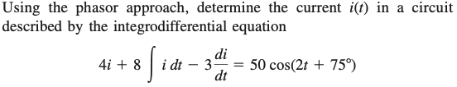

Slide 39
9.4 Phasor relationships for circuit elements
VCR of Resistor in Phasor domain
VCR of Inductor in Phasor domain
VCR of Capacitor in Phasor domain

Slide 40

VCR of Resistor in Phasor domain

Slide 41

VCR of Resistor in Phasor domain

Slide 42
Instantaneous power
Average power

Slide 43
VCR of Inductor in Phasor domain

Slide 44

VCR of Inductor in Phasor domain

Slide 45

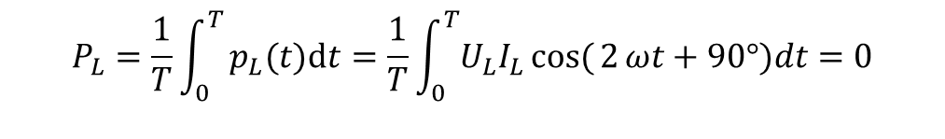
Energy Storage
Instantaneous power：
$p_{L}(t)=u_{L}i_{L}=U_{L}I_{L}cos({2}ωt+$90°)
Average power：
$$P_{L}=\frac{1}{T}\int_{0}^{T}{p_{L}(t)dt=\frac{1}{T}\int_{0}^{T}{U_{L}I_{L}cos({2}ωt+90°)dt=0}}$$
Magnetic energy stored:

Slide 47
VCR of Capacitor in Phasor domain

Slide 48
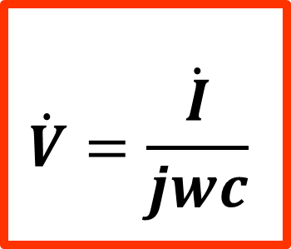
VCR of Capacitor in Phasor domain

Slide 49
Energy Storage
Instantaneous power：
$$p_{C}(t)=u_{C}(t)i_{C}(t)=\sqrt{2} U_{C}\cos{ω}t\sqrt{2}I_{C}\cos{(}ωt+90^{°})=U_{C}I_{C}\cos{(2}ωt+90°)$$
Average power：
Electric energy stored：

Slide 51
Summary of voltage-current relationships
Element
Time domain
Frequency domain
R
L
C

Slide 52
9.5 Impedance and Admittance
Impedance Z:
defined as the ratio of the phasor voltage to the phasor current.
:measured in ohms (Ω)
Admittance Y:
defined as the reciprocal of impedance.
:measured in siemens (S)

Slide 53
Impedances and admittances of passive elements
Element
Impedance
Admittance
R
L
C

Slide 54
Reactance and Susceptance
Reactance:
defined as the imaginary part of the impedance.
:measured in ohms (Ω)
Susceptance:
defined as the imaginary of the admittance.
:measured in siemens (S)

Slide 55
R
L
inductive reactance
C
capacitive reactance
Impedance, resistance, and reactance are all measured in ohms (Ω).

Slide 56
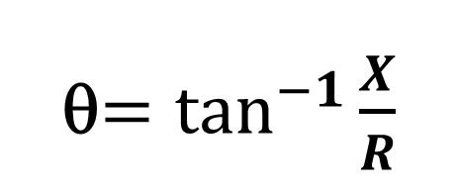
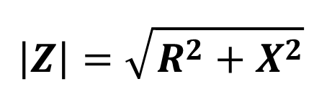
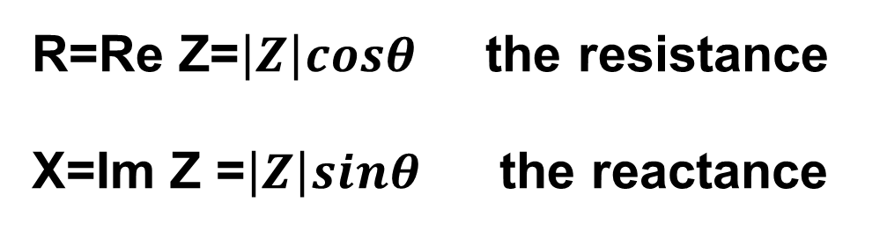
The impedances and admittances of two-terminal passive networks
+
N₀
－

Slide 57
+
N₀
－
G=Re Y the conductance
B=Im Y the susceptance
Admittance, conductance, and susceptance are all measured in siemens (or mhos).

Slide 58
R
L
inductive susceptance
C
capacitive susceptance

Slide 59
Ohm’s Law in Frequency Domain

Slide 60
Exercise
True or False?
Resistor
Inductor
Capacitor
上一节
下一节

Slide 61
Example

Slide 62
Example

Slide 63
Circuits in Frequency Domain

Slide 64
9.6 Kirchhoff’s laws in the frequency domain
KVL in frequency domain
KCL in frequency domain

Slide 65
KVL in Frequency Domain
The algebraic sum of all the phasor voltages around a closed loop is ZERO.

Slide 66
Proof:

Slide 67
KVL in Frequency Domain

Slide 68
KCL in Frequency Domain
The algebraic sum of all the phasor currents entering a node(or a closed boundary) is ZERO.

Slide 69
Proof:

Slide 70
KCL in Frequency Domain

Slide 71
9.7 Impedance combinations
By KVL in phasor:

Slide 72
Impedances in Parallel
By KCL in phasor:

Slide 73
Voltage/Current Division

Slide 74
Y-Δ Conversion:

Slide 75
Δ-Y Conversion:

Slide 76
The Y and ∆ circuits are said to be balanced when
Under these conditions, conversion formulas become

Slide 77
Example
Find the steady-state current i(t) and voltages across all passive elements.

Slide 78
Solution:

Slide 79
Apply KVL to the loop:

Slide 81
Example: RLC series-connected circuit
1、 instantaneous expression
Applying KVL
+
+
R
_
+
L
_
Let
+
_
C
then
_
Sinusoids with the same w
上一节

Slide 82
Phasor
(1)phasor form
+
+
R
_
Let
(the reference phasor)
+
jX_{L}
then
_
+
_
-jX_{C}
_
下一页

Slide 83
Let
impedance
Ohm’s law in phasor form
then
Z is a complex number instead of a phasor.
Notice

Slide 84
magnitude：
phase：
ϕ is determined by circuit parameters.
if X_{L} >X_{C}， 90° >ϕ > 0 ，u leads i be inductive
if X_{L} < X_{C}, －90° <ϕ < 0 ， u lags i be capacitive
if X_{L} = X_{C}，ϕ = 0 , u and i are in phase be resistive

Slide 85
(2) phasor diagram
Reference phasor
+
+
R
_
X_{L} < X_{C}
X_{L} > X_{C}
+
jX_{L}
_
+
( ϕ > 0 inductive)
( ϕ < 0 capacitive)
_
-jX_{C}
_
voltage
triangle

Slide 86
(2) phasor diagram
Voltage
triangle
impedance
triangle
上一节

Slide 87

True or False?
RLC series-connected circuit
let
√
？
？
√
？
√
？
？
√
？
？
√
？
？
？
？
？
？
？
上一页
下一页

Slide 88
Example in Fig.(c)，V₁:15 V;V₂:80 V;V₃:100 V
find effective value U_{s2}.
Solution Phasor model is shown in Fig. (d)
V₁
R
jωL
R
+
u_{s2}
i
L
V₂
(d)
C
V₃
(c)

Slide 89
Discussion
1. Given
A₁
A₂
A₃
+
The ammeter A₁ reads 3A
Find: (1) The readings of ammeters A₂
andA₃ respectively?
-
(2)The equivalent impedance Z at terminals ?
+
2. In the circuit, if
Then the circuit is inductive.
-
True or false?
89
返 回
上一节
下一节
上一页
下一页

Slide 90
Example：
In the circuit, I₁=10A、U_{AB} =100V
Find：the readings of the voltmeter and ammeter respectively.
A
C₁
B
A
V
Solution：having known the voltage across the capacitor and the current through it, find the current I and the voltage V.
Two methods： (1) phasor calculation;
(2) phasor diagram
90
返 回
上一节
下一节
上一页
下一页

Slide 91
A
C₁
B
Given：I₁= 10A、
U_{AB} =100V，
A
Find: the readings of A and V
V
Method 1: phasor calculation
Let
be the reference phasor
Then：
The reading of the ammeter A is 10 A.
91
返 回
上一节
下一节
上一页
下一页

Slide 92
A
C₁
B
Given：I₁=10A、
U_{AB} =100V，
A
Find: the readings of A and V
V
Since
Therefore
Therefore, the voltmeter reads 141 V.
92
返 回
上一节
下一节
上一页
下一页

Slide 93

A
C₁
B
Given: I₁=10A、
U_{AB} =100V，
A
Find: the readings of A and V
V
Method 2: phasor diagram
Phasor diagram：
Assuming to be the reference phasor
leads
by
10$\sqrt{2}$
45°
lags
by
From the phasor diagram
I =10 A
93
返 回
上一节
下一节
上一页
下一页

Slide 94


A
C₁
B
Given：I₁=10A、
U_{AB} =100V，
A
Find: the readings of A and V
V
Assuming to be the reference phasor
100$\sqrt{2}$
U_{L}= I X_{L} =100V
10$\sqrt{2}$
45°
From phasor diagram：
45°
100
V=141V
94
返 回
上一节
下一节
上一页
下一页

